Slide 1
Microsoft SQL Server
Presented By:Er.Sudan Prajapati

Slide 2
Introduction
Microsoft SQL Server is a Relational Database Management System (RDBMS) designed to run on platforms ranging from laptops to large multiprocessor servers.
SQL Server is commonly used as the backend system for websites and can support thousands of concurrent users.
SQL Server comes with a number of tools to help you with your database administration and programming tasks.
SQL Server is much more robust and scalable than a desktop database management system such as Microsoft Access.

Slide 3
Anyone who has ever tried using Access as a backend to a website will probably be familiar with the errors that were generated when too many users tried to access the database!
Although SQL Server can also be run as a desktop database system, it is most commonly used as a server database system.

Slide 4
Server Database Systems
Server based database systems are designed to run on a central server, so that multiple users can access the same data simultaneously.
The users normally access the database through an application.
For example, a website could store all its content in a database.
Whenever a visitor views an article, they are retrieving data from the database. As you know, websites aren't normally limited to just one user
So, at any given moment, a website could be serving up hundreds, or even thousands of articles to its website visitors.

Slide 5
At the same time, other users could be updating their personal profile in the members' area, or subscribing to a newsletter, or anything else that website users do.
Generally, it's the application that provides the functionality to these visitors.
It is the database that stores the data and makes it available.
Having said that, SQL Server does include some useful features that can assist the application in providing its functionality.

Slide 6
SQL Server Management Studio (SSMS)
SQL Server Management Studio (SSMS) is the main administration console for SQL Server.
SSMS enables you to create database objects (such as databases, tables, views etc), view the data within your database, you can configure user accounts, transfer data between databases, and more.
SQL Server Management Studio looks like when you first open it up:

Slide 7
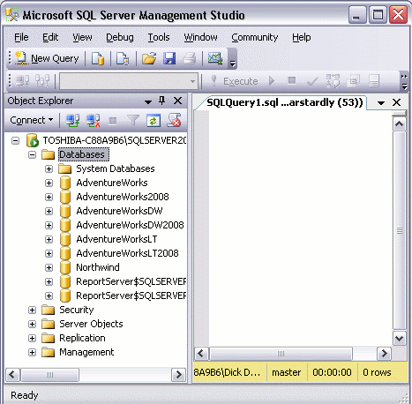

Slide 8
The left pane contains the Object Explorer.
The Object Explorer provides navigation to databases, server objects (such as triggers), log files, and more.
The right pane allows you to write queries against the database and view the results.
In the screenshot there is opened a blank query by clicking the "New Query" button
You can use SQL Server Management Studio to create as many databases as you like.
Most of the tasks performed with SQL Server Management Studio are initiated either from the top menu, or by right-clicking on an icon/object.
Throughout most of this tutorial, we'll be looking at the various things you can do via SQL Server Management Studio.

Slide 9
System Databases
If SQL Server is installed , you might notice that some databases have already been created.
These are system databases.
Database | Type | Description
master | System database | Stores system level information such as user accounts, configuration settings, and info on all other databases.
model | System database | This database is used as a template for all other databases that are created.
msdb | System database | Used by the SQL Server Agent for configuring alerts and scheduled jobs etc
tempdb | System database | Holds all temporary tables, temporary stored procedures, and any other temporary storage requirements generated by SQL Server.

Slide 10
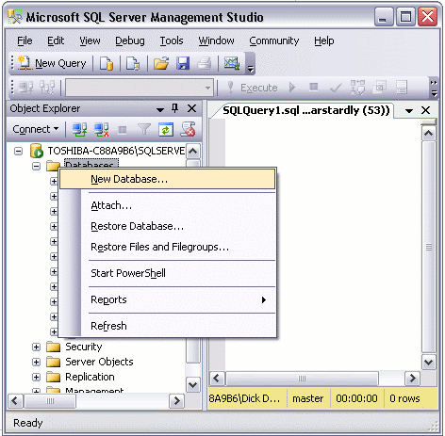
Creating a New Database
Right click on the "Databases" icon and select "New Database...“

Slide 11
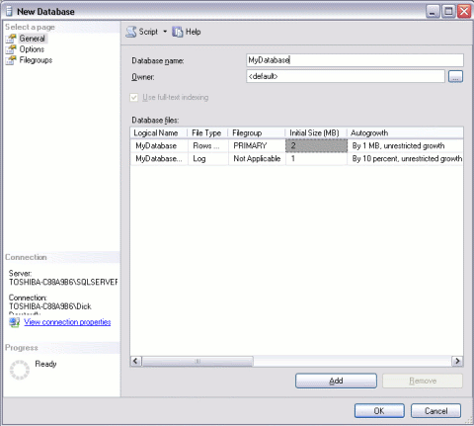
Creating a New Database
Name your database and click "OK“

Slide 12
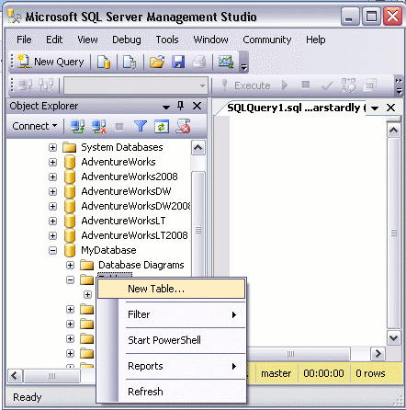
Create a Table
Ensuring you have the right database expanded, right click on the "Tables" icon and select "New Table...":

Slide 13
complete the details in the "Column Name" column, the "Data Type" column, and "Allow Nulls" column.
Make the Individual Id column an "identity column", by setting "Is Identity" to "Yes" (this option is under the "Identity Specification" section in the bottom pane).
Note that to set values in the bottom pane, you need to select the column name in the top pane first.
This column is going to be an auto-number column - it will contain an incrementing number for each record that is created.
Set the "Default Value" of the DateCreated column to (getdate()). (This will automatically insert the current date into that field for each new record).

Slide 14
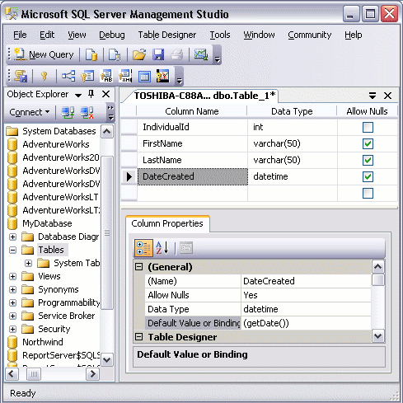

Slide 15
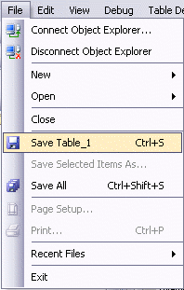
Save the table by selecting File > Save Table_1:

Slide 16
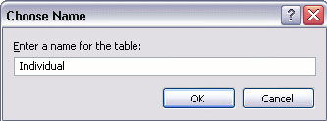
When prompted, name your table:

